Slide 1

Le Wagon
The beginning of your journey
Notes:
欢迎加入我们le wagon part-time产品开发培训营！你们准备好了吗！

Slide 2

程序员的思维方式
Notes:
程序员的思维方式是什么呢？

Slide 3
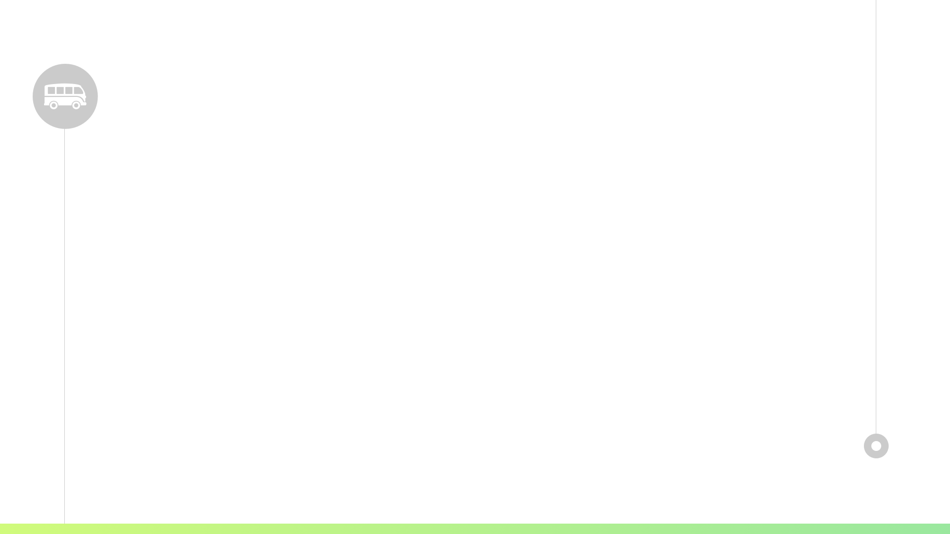
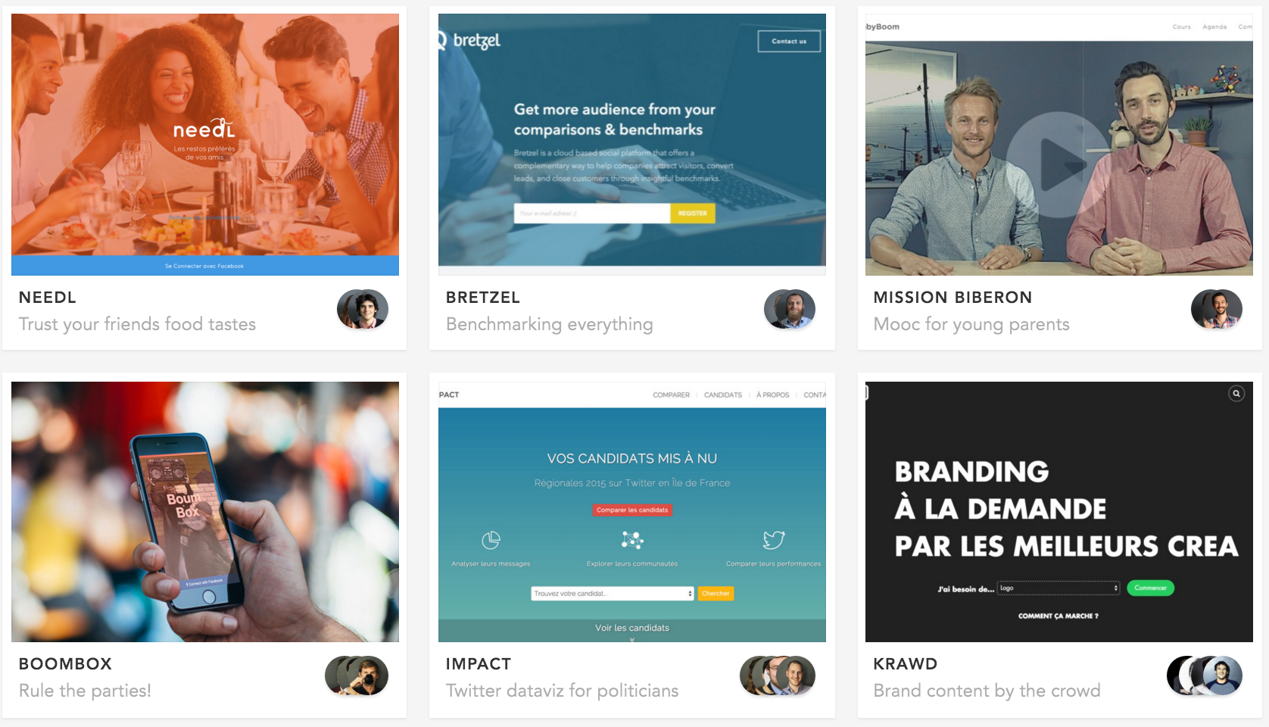
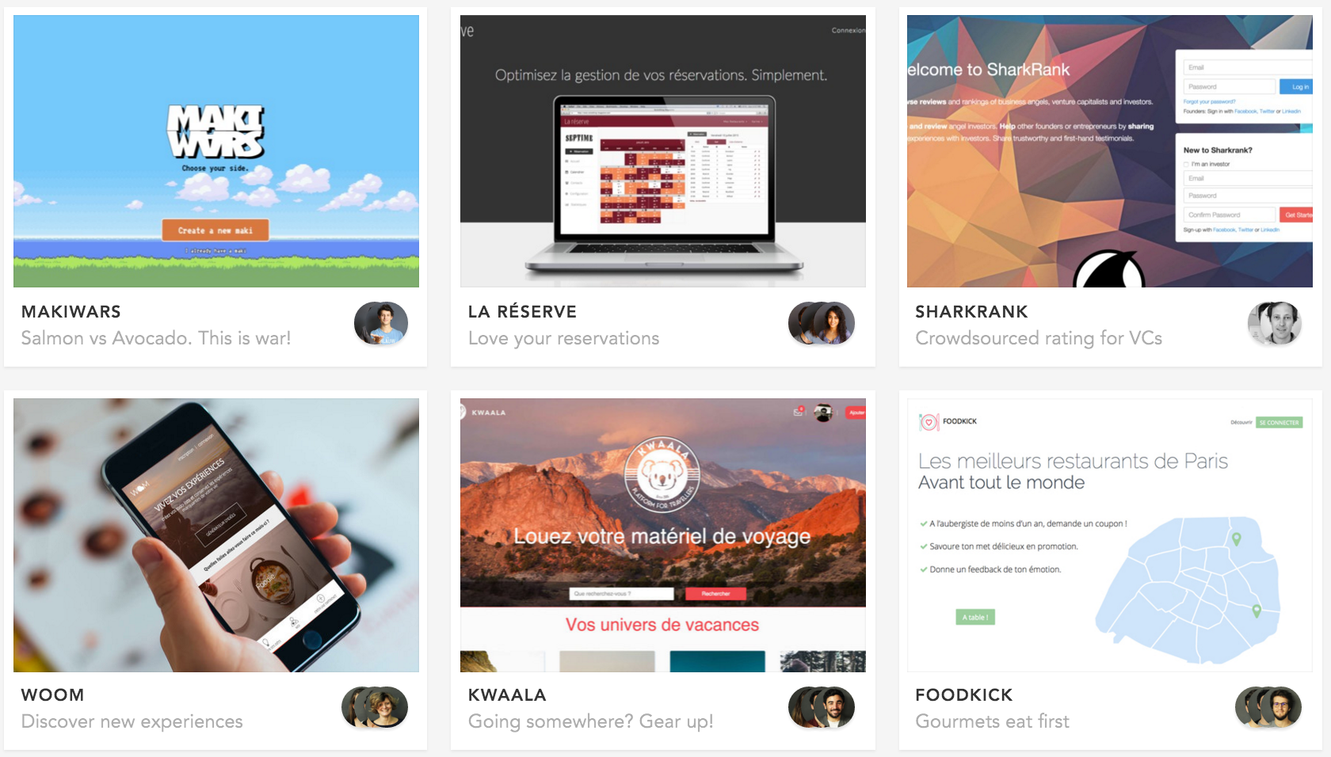
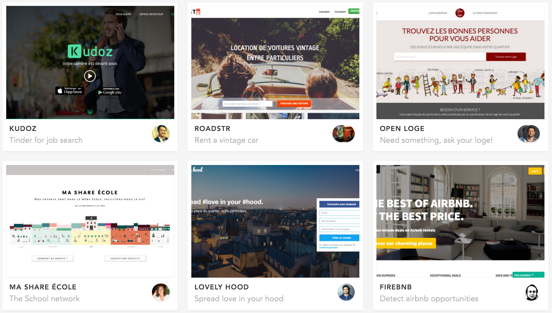
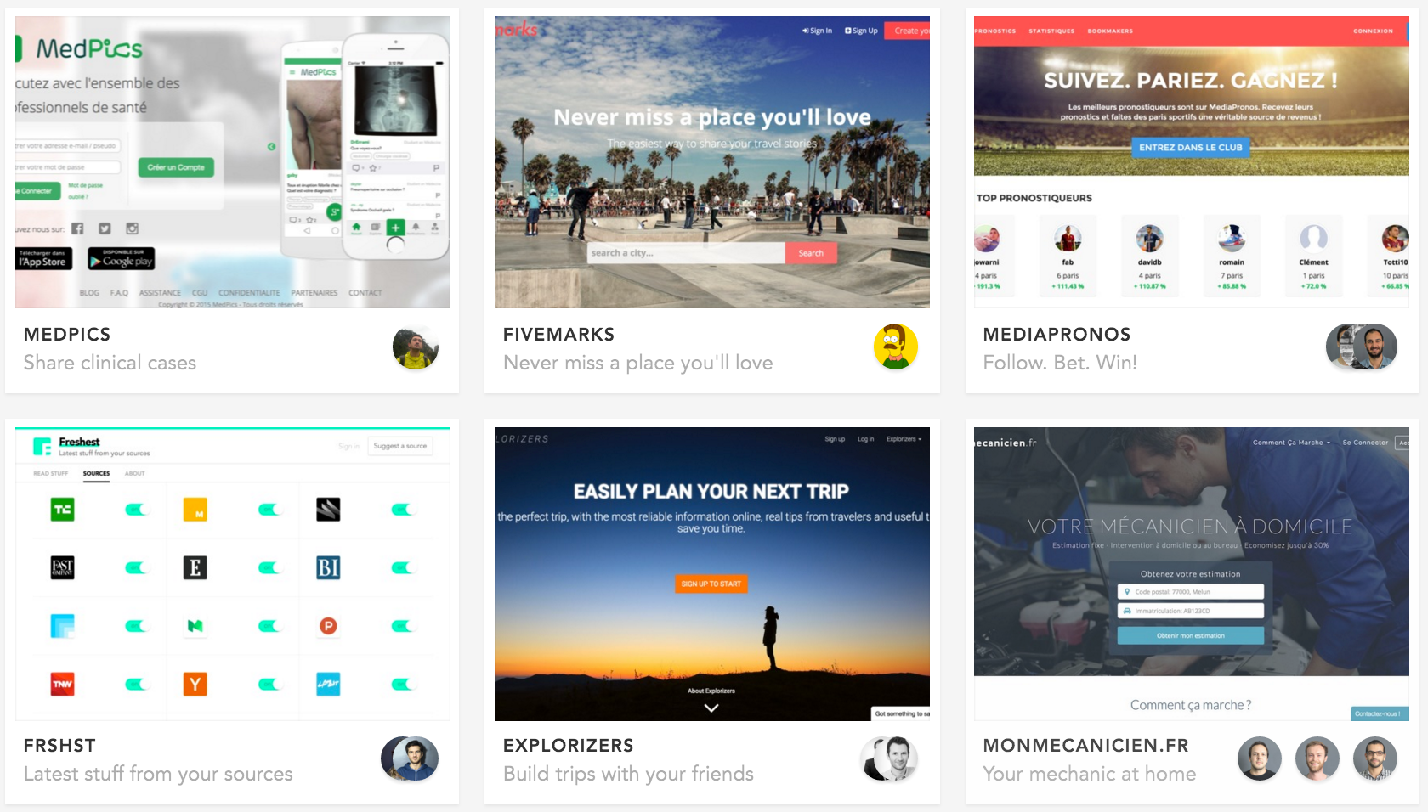
代码是用来
构建产品的🔨
Notes:
很简单：他们用代码来构建产品

Slide 4
需要丰富的知识及技能💪
Notes:
编码需要丰富的知识以及技能，这就不用多说了

Slide 5
代码的定义是
产品思考：构建什么样的产品🤔
工程：如何打造你的产品⚙️
UI & UX：如何让你的产品更直观👌
设计：如何美化你的产品💖
Notes:
代码到底是什呢？
需要考虑到四个主要方面
1. Product thinking 你想构建什么样的产品呢？
2. Engineering工程：如何打造你的产品
3. UI & UX：如何让你的产品直观4.
4. 设计：如何美化你的产品

Slide 6

我们不会像传统的CS degree那样教你
我们将教你如何制造产品
Notes:
我们不会像传统计算机科学学位那样教你
而 我们将教你如何制造产品

Slide 7
然而，没有捷径😊
本课程将涵盖主要的编程概念
Notes:
然而，没有捷径 méi yǒu jié jìng
there are no shortcuts
本课程将涵盖一些主要的编程概念

Slide 8

Hold on.
Trust us.
Stay curious.
Notes:
你会发现这门课很有挑战性，
但不用担心，
不要放弃
相信我们
保持好奇心

Slide 9
⌚ 每周二和四的日常安排
18:30 - 19:00 | 到达Xnode（17F）
19:00 - 20:30 | Lecture
20:30 – 20:00 | 与当天安排的buddy完成exercise
Notes:
准时到达
教课

Slide 10
⌚ 每周六的日常安排
8:30 - 9:00 | 到达Xnode（9F）
9:00 – 18:00 | 与当天安排的buddy完成challenge

Slide 11
📅 每周概述

Slide 12


First week
writing 1-file programs in ruby
Week 1
8 Oct 2018 | Setup
9 Oct 2018 | Programming Basics
10 Oct 2018 | Flow, Conditionals & Arrays
11 Oct 2018 | Iterators & Blocks
12 Oct 2018 | Hash & Symbols |  | Quiz

Slide 13

Second week
Reboot 🚀 / starting building softwares Classes, several files, no more 1-file programs
Week 2
15 Oct 2018 | Regular Expressions |  | Reboot
16 Oct 2018 | Parsing |  | Reboot
17 Oct 2018 | Classes & Instances
18 Oct 2018 | Inheritance & Self
19 Oct 2018 | Cookbook (Day 1)

Slide 14



Third week
End of software engineering (Food Delivery Challenges 😭) Let’s play with databases and SQL
Week 3
22 Mar 2018 | Cookbook (Day 2)
23 Mar 2018 | Food Delivery (Day 1)
24 Mar 2018 | Food Delivery (Day 2)
25 Mar 2018 | Schema Design & SQL
26 Mar 2018 | CRUD with SQL

Slide 15


4th week
End of database Quitting the terminal… Let’s build web interfaces 🎉
Week 4
29 Oct 2018 | Active Record Basics
30 Oct 2018 | Associations & Validations |  | Quiz
31 Oct 2018 | HTML & CSS |  | 小程序 101
1 Nov 2018 | CSS Components
2 Nov 2018 | Bootstrap, Grids & Layouts |  | ICP Beian

Slide 16

5th week
A dive into Javascript
Week 5
5 Nov 2018 | Middleman |  | Pitch Night
6 Nov 2018 | JavaScript & the DOM
7 Nov 2018 | DOM Events & AJAX
8 Nov 2018 | JavaScript Tooling
9 Nov 2018 | Product Design Sprint |  | Demo
SAT
10 Nov 2018 | 小程序 part 1

Slide 17

6th week
Wrapping all together 🎁 One Rails app a day keeps the doctor away
Week 6
12 Nov 2018 | Routing, Controllers & Views
13 Nov 2018 | Models & CRUD
14 Nov 2018 | Advanced Routing
15 Nov 2018 | Front-end
16 Nov 2018 | Hosting & Image Upload |  | Quiz
SAT
17 Nov 2018 | 小程序 part 2

Slide 18
7th week - Airbnb week
Final teams are built Let’s collaborate & clone Airbnb
Week 7
19 Nov 2018 | Authentication & Devise |  | Airbnb Day 1
20 Nov 2018 | Authorization & Pundit
21 Nov 2018 | Geocoding |  | Demo
22 Nov 2018 | Search
23 Nov 2018 | Tags |  | Demo

Slide 19

8th week - Project week #1
Please, no market place 🙏
Let’s innovate and invent creative products 😍
Week 8
26 Nov 2018 | Weixin Official Account
27 Nov 2018 | Mailing
28 Nov 2018 | Weixin Backend / Payment
29 Nov 2018 | Background Jobs with Sidekiq
30 Nov 2018 | Testing in Rails |  | Demo

Slide 20
9th week - Project week #2
Let’s finalise our products and make great demos!
Week 9
3 Dec 2018
4 Dec 2018
5 Dec 2018
6 Dec 2018 | Dress Rehearsal |  | Demo
7 Dec 2018 | Demo Day

Slide 21
规则
不要迟到 ⏰
上课期间不允许食物🙅‍♂️
Lecture期间不要使用手机或笔记本电脑📵
与当天安排的buddy一起合作👯‍♀️
离开时要保持桌面整洁及干净

Slide 22
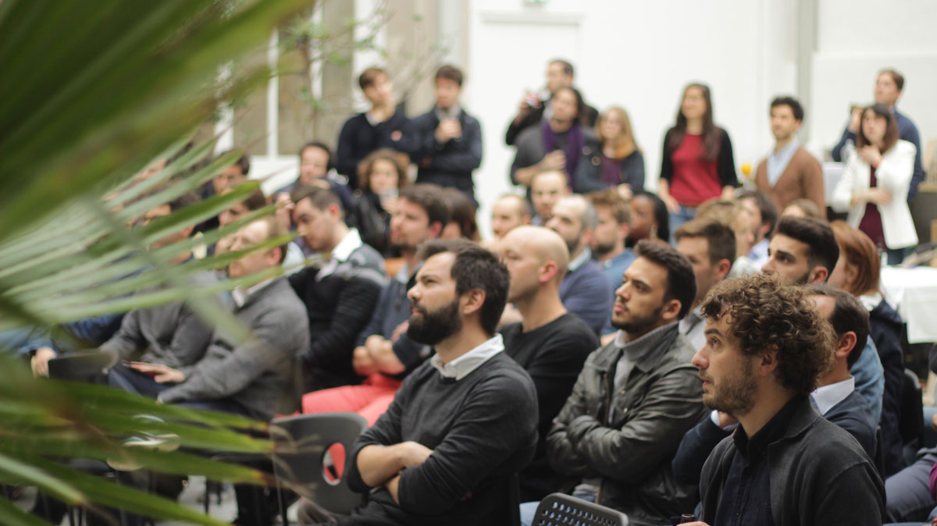
🎉 Social
🎤 活动/演讲
Notes:
我们le wagon也会举办一些活动，大家可以参与，多认识一些公司，CEO等。
- 下周五，我们le wagon将举办一个alumni活动，正好给大家个计会能互相认识 还有 social一下

Slide 23
🕑 今天的安排
Today
10:30 - 12:00 | Setup
13:00 - 13:15 | Lecture: 命令行
13:15 - 14:00 | Lecture: Git
14:00 – 14:15 | 介绍学习平台
14:15 – 16:00 | 午饭 + 完成challenge
16:00 | Pitch + 投票

Slide 24
准备好了吗？ 🚀
Notes:
大家准备好了吗？

